Slide 1
What is a Software..?
Software is basically a set of instructions or commands that tell a computer what to do. In other words, the software is a computer program that provides a set of instructions to execute a user's commands and tell the computer what to do.

Slide 2
What is software testing ?
A procedure intended to establish the quality, performance or reliability of software applications, especially before it is taken into wide spread use.
Software testing is a process of verifying and validating software to ensure it meets the specified requirements and functions

Slide 3
MANUAL TESTING
AUTOMATION TESTING

Slide 4
Why do you choose software testing as career?
Testing will be there in the market forever as long as quality demanded in the market.
Testing is mandatory for the industry.
Independent of technology.
Consistent and stable

Slide 5
WHY do we need SOFTWARE TESTING
It is important because if there are any bug or errors in the software it can be identified early and can be resolved before delivery of the product.
It is required to point out the defects & errors that were made during development phase .
a tested software product ensures reliability, security & high performance .which result cost effectiveness & customer satisfaction.

Slide 6
Principle of Software Testing
1) Testing shows presence of defects NOT their absence
2) Absence of error is a fallacy.
3) Early testing saves time and money
4) Exhaustive testing is impossible.
5)Beware of pesticide paradox
6) Testing is context dependent
7)Defect clustering .(PARETO-80-20)

Slide 7
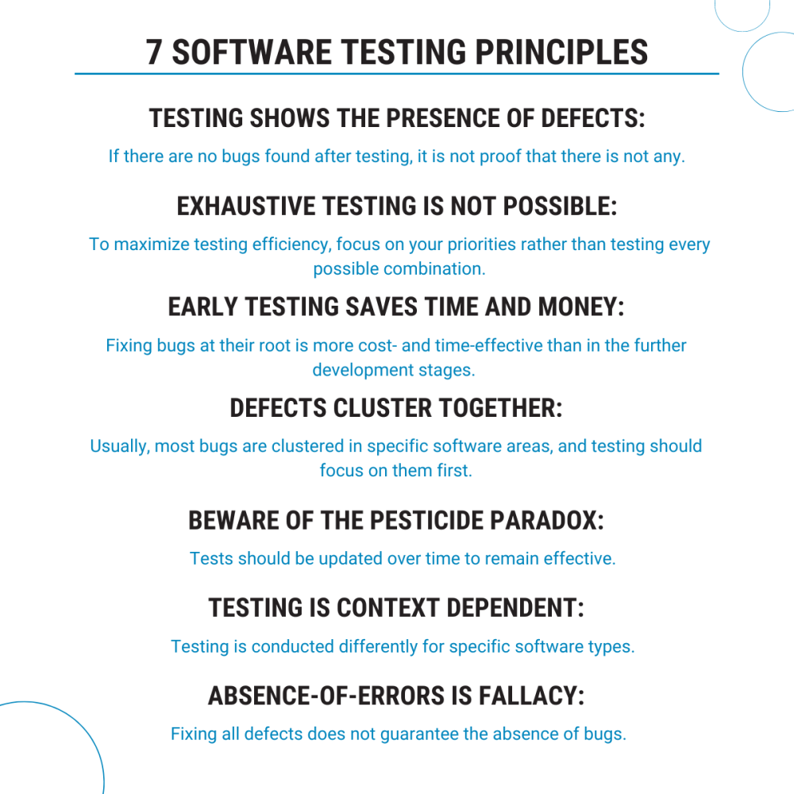

Slide 8
PDCA Cycle
The plan-Do-Check-Act (PDCA) cycle is an iterative four step management method used in business to focus on continuous improvement of process, product or services and to resolve problems.
P-Plan.
D-Do.
C-Check.
A-Act.

Slide 9
Phases in PDCA cycle
Plan- define the objective, strategy and supporting methods to achieve the goal of a plan.
Do- here we implement the plan.
Check- Evaluate the results to make sure whether we reach the goal as planned.
Act- Take action on what is not working as planned.

Slide 10
Quality
It is defect free, robust, efficient and reliable, easy to learn and use product solutions
It allowed to meet customer expectations, improves productivity.

Slide 11
FIVE PERSPECTIVE OF QUALITY
Transcendent - I know it when I see it.
Product based – processes desired features.
User based – Fitness for use.
Development and manufacturing based – Confirms to requirements.
Value based – At an acceptable cost .

Slide 12
Static Testing
software application is tested without code execution. The main objective of static testing is to improve the quality of software applications by finding errors in early stages of software development process.

Slide 13
Dynamic Testing
a code is executed. It checks for functional behaviour of software system, memory/cpu usage and overall performance of the system

Slide 14
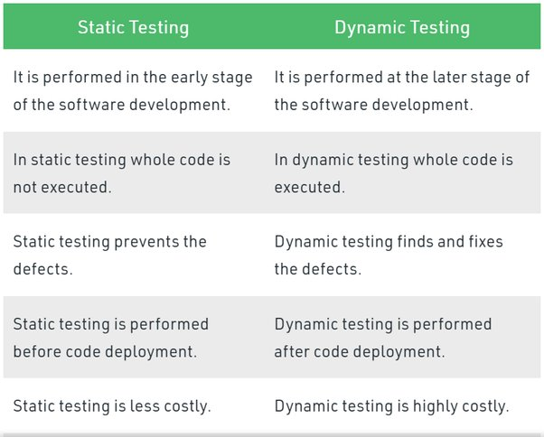

Slide 15
Verification in Software Testing
It is a process of checking documents, design, and program in order to check if the software has been built according to the requirements or not.
Use : To identify defect in the product early in the life cycle.
The verification process involves activities like reviews ,walkthrough, and inspection.

Slide 16
Validation in Software TESTING
It is a dynamic mechanism of testing and validating if the software product actually meets the exact needs of the customer or not.
The process helps to ensure that the software fulfils the desired use in an appropriate environment.
The validation process involves activities like unit testing, integration testing, system testing and user acceptance testing.

Slide 17
Quality assurance
Quality Assurance is popularly known as QA Testing, is defined as an activity to ensure that an organization is providing the best possible product or service to customers.
Quality Control
The main purpose of the quality control process is ensuring that the software product meets the actual requirements by testing and reviewing its functional and non-functional requirements.

Slide 18
Quality Assurance (QA) vs. Quality Control (QC)
Quality Assurance (QA) | Quality Control (QC)
It is a procedure that focuses on providing assurance that quality requested will be achieved | It is a procedure that focuses on fulfilling the quality requested.
QA aims to prevent the defect | QC aims to identify and fix defects
It is a method to manage the quality- Verification | It is a method to verify the quality-Validation
It does not involve executing the program | It always involves executing a program
It’s a Preventive technique | It’s a Corrective technique
QA involves in full software development life cycle QA is a process oriented | QC involves in full software testing life cycle QC is product oriented

Slide 19
What makes a good software tester
A good test engineer should have a test to break attitude
An ability to take the point of view of the customer
Strong desire for quality and attention to minute details
Tact and diplomacy to maintain a corporative relationship with both technical (developers)and non technical (customers, management) peoples
Prior experience in the software development industry is always a plus
Ability to judge the situations and make important decisions

